Slide 1
Azure Brushup

Slide 2




Slide 3
Azure AD
Identity and Access Management Service
User and Group Management
Licenses
App Registrations
Self Service Password Reset

Slide 4
Subscription 1
RG 1
RG 2
RG 3
Subscription 2
RG 4
RG 5
User 1
User 2
User 3
User 4
User 5
Group 1
Group 2
Group 3
Group 4
Group 5
Management Group
Subscription 1
Subscription 2
RG2
RG3
RG4
RG5
RG1

Slide 5
Azure Virtual Machines
IaaS Cloud Services
Planning Checklist
Start with Vnet
Name of the VM
Decide the location
Determine the size
Storage for the VM
Operating System

Slide 6
High Availability
Availability Sets - Rack
Availability Zones - Datacenter
Virtual Machine Scale Set – Auto Scaling

Slide 7
Storage
Scalable object Store – Blob Storage
File system service for the cloud – File Share
Messaging Store – Queue Storage
NoSQL store – Tables
Types:
General Purpose v2
General Purpose v1
Blob Storage

Slide 8


Redundancy
LRS
ZRS
GRS
RA-GRS
GZRS
RA-GZRS

Slide 9
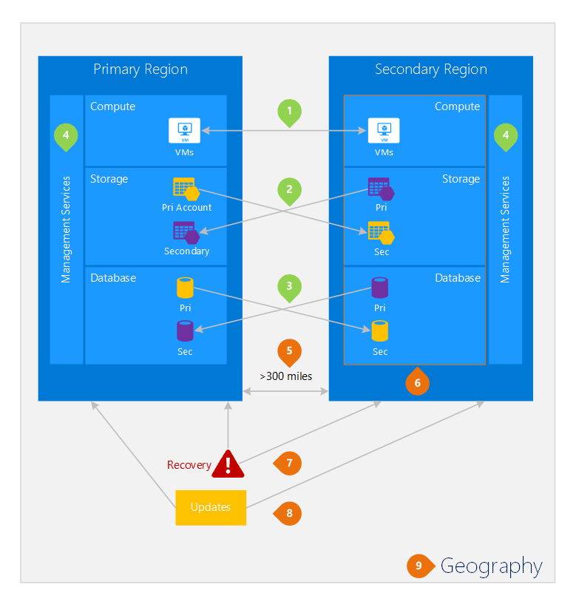

Slide 10
Virtual Network
Representation of your own network in the cloud.
CIDR – Classless Interdomain Routing
Address Space: 10.0.0.0/16
Subnet: VNet segmented into one or more subnets
Service Endpoint – Extends virtual network to service

Slide 11
IP Addressing
Public IP
Private IP

Slide 12
Network Security Group
A service to limit the network traffic to resources in a virtual network
Inbound Rules
Outbound Rules

Slide 13





















Azure Load Balancer
High availability and network performance to your applications
OSI Layer 4

Slide 14
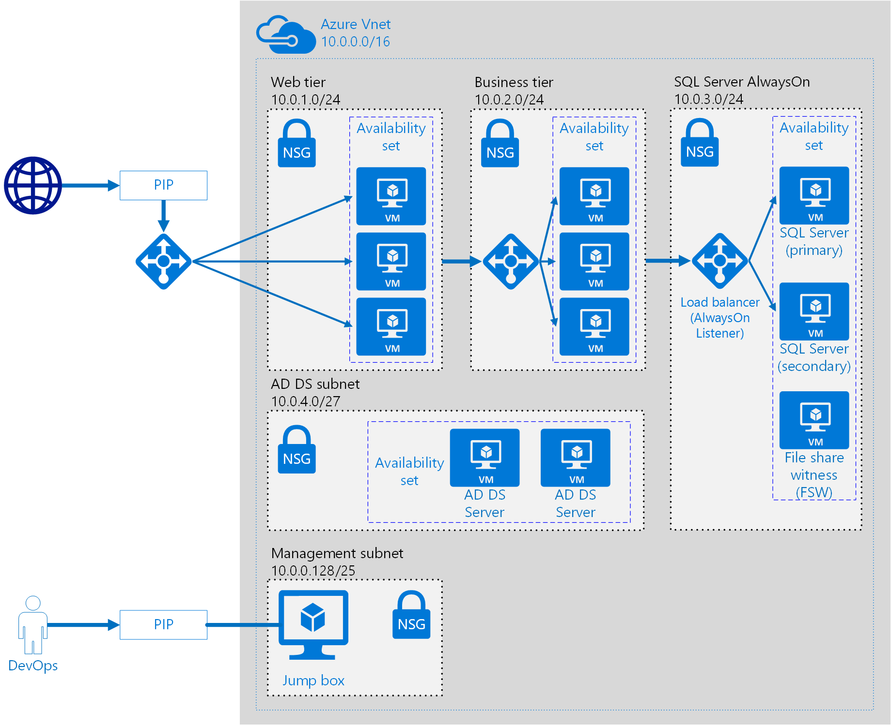




















Slide 15
Azure App Service
PaaS from Microsoft to deploy, design and scale web apps
App Service
App Service Plan

Slide 16

App Service
Container Instance
AKS

